Slide 1

Pallanguzhi 2D Board Game

Slide 2
Project Team :
Team Members
HENOTHAN R [2022115303]
VIGNESH V [2022115322]
MENTOR
DR. P. GEETHA

Slide 3
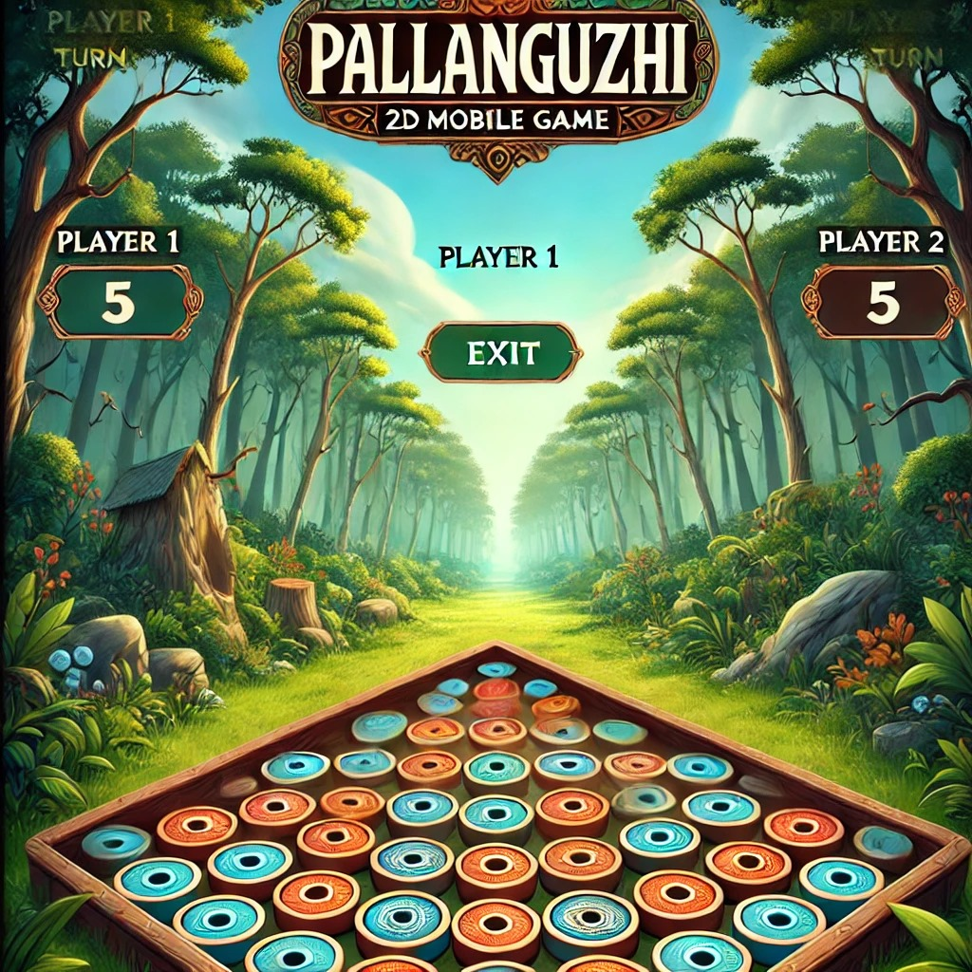
Introduction :
Pallanguzhi is a traditional Indian mancala game that has been enjoyed for generations. Our project aims to bring this classic game to a digital platform using Flutter, a powerful framework for building cross-platform applications.

Slide 4
Problem Definition :
Preserve and honor the rich cultural heritage of Pallanguzhi in a digital format.
Make the game more accessible by moving from physical to mobile platforms.
Engage younger audiences through an intuitive and modern interface.
Ensure a user-friendly and engaging experience for all players.
Optimize the game for seamless play on Android and iOS devices.
Broaden engagement with Pallanguzhi by increasing convenience and accessibility.

Slide 5
Objectives :
Develop a User-Friendly Interface
Implement Accurate Gameplay Mechanics
Enhance Accessibility
Optimize Performance Across Devices
Promote Cultural Awareness

Slide 6
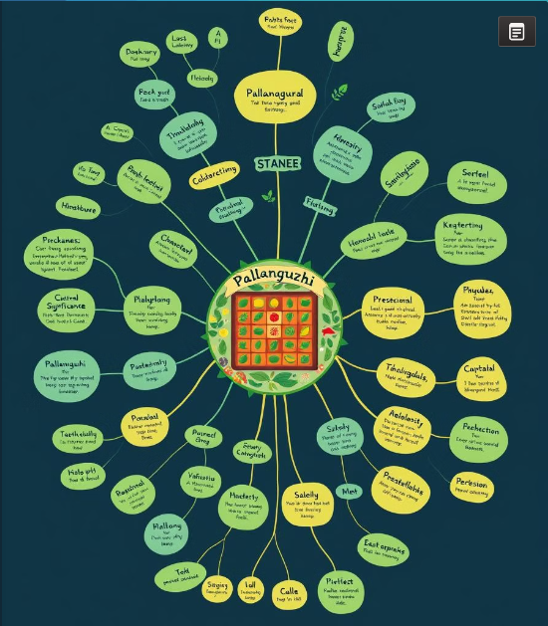
Survey/Ideas :
Players appreciate straightforward and engaging gameplay.
A clean, easy-to-navigate user interface is highly valued.
Smooth animations for coin movements enhance the experience.
Responsive design is crucial for mobile device compatibility.
Focus on optimizing touch interactions and maintaining a seamless gameplay flow.

Slide 7
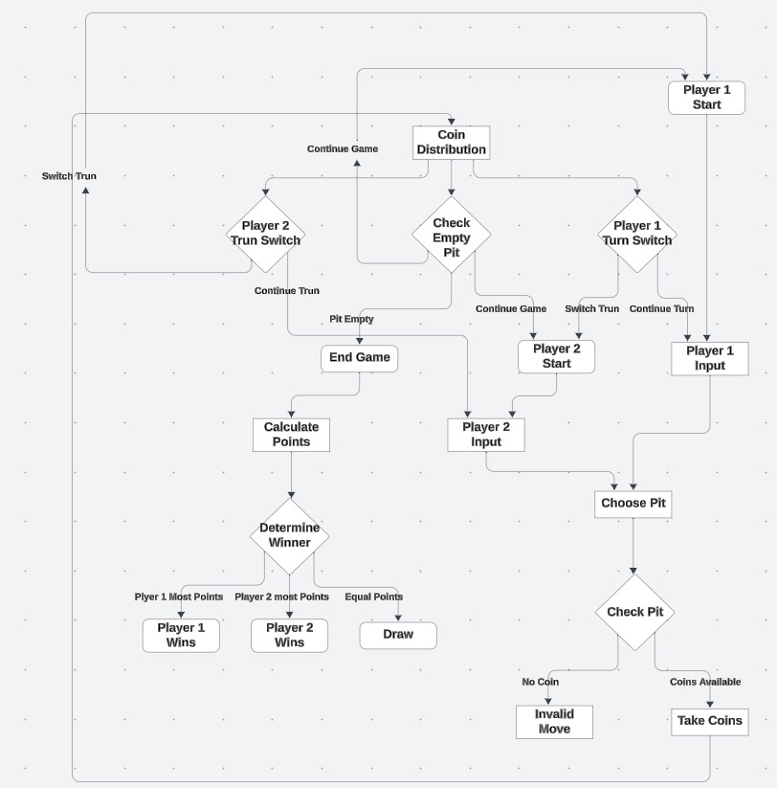
System Architecture :

Slide 8
Detailed Design :
Game board created using CustomPainter in Flutter, with pits represented as circular containers.
Coin movement visualized through AnimatedContainer for smooth transitions between pits.
Alternating turn-based system tracks each player's moves and seed distribution.
Dynamic scoring system updates based on captured seeds for each player.
Simple UI design ensures smooth gameplay across screen sizes, with menu options for Information about Game, Restart, and Exit.

Slide 9

Tools and Technologies Used :
Frame Work:
Flutter
Programming Language:
Dart
Graphics and Design:
Adobe Photoshop
Canva
Integrated Development Environment (IDE):
Google IDX

Slide 10
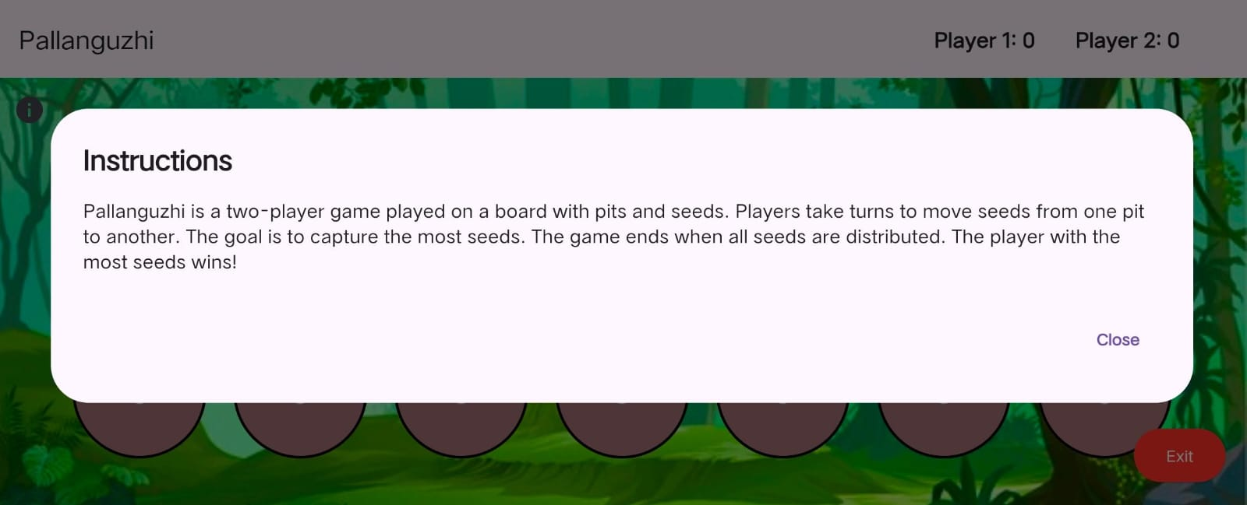
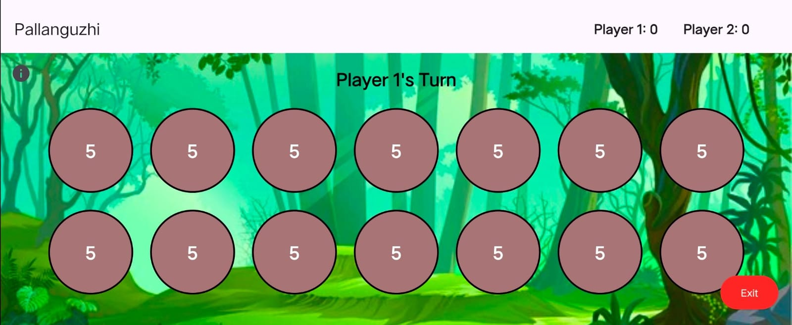
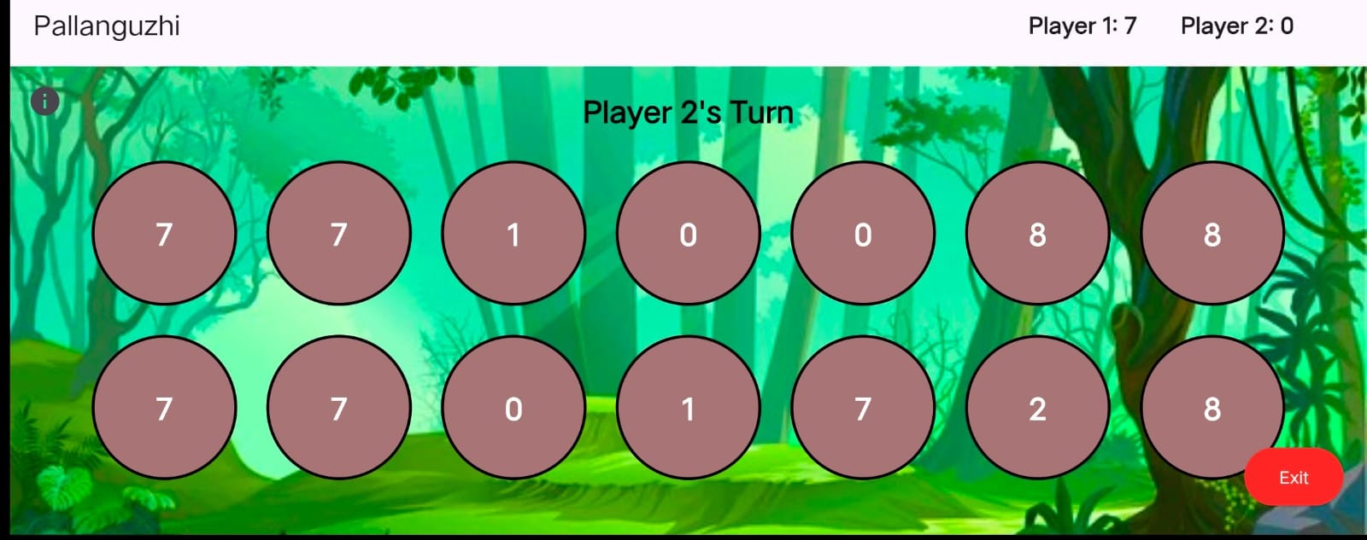
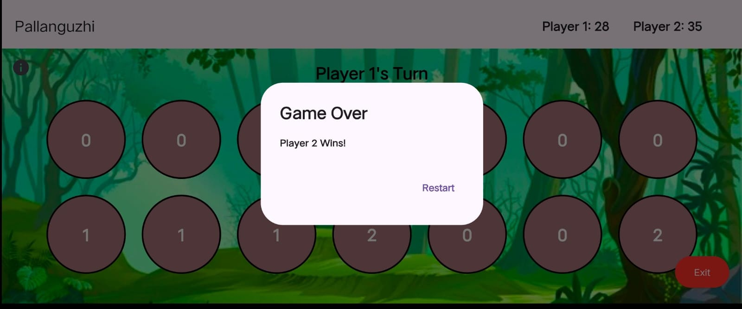
Screenshot of the Output :

Slide 11
RESULTS AND DISCUSSIONS :
Successfully deployed on Android and iOS platforms.
Real-time scoring and accurate turn-based logic implemented.
Smooth performance on most devices with optimized animations.
Positive feedback on simple, traditional gameplay with modern touch-based interaction.
Overcame challenges with seed movement animations, UI scaling, and random coin toss for starting player.

Slide 12
REFERENCE :
Flutter Documentation : flutter.dev
Pallanguzhi Game Logic: Studied existing rules and implementations to ensure accurate game mechanics.
UI/UX inspiration: Existing digital Pallanguzhi games like Kalah and other traditional versions.
​Youtube : http://www.youtube.com/@owencoopersfx

